Slide 1


Defining Data Warehouse Concepts and Terminology
Chapter 3

Slide 2
Defining a Data Warehouse
“ An enterprise structured repository of subject-oriented, time-variant, historical data used for information retrieval and decision support. The data warehouse stores atomic and summary data.”
Oracle Data Warehouse Method

Slide 3

Data Warehouse Properties
Subject Oriented
Integrated
Data Warehouse
Non Volatile
Time Variant

Slide 4

Subject-Oriented
Data is categorized and stored by business subject rather than by application
OLTP Applications
Data Warehouse Subject
Equity Plans
Customer financial information
Insurance
Loans
Shares
Saving

Slide 5

Time-Variant
Data is stored as a series of snapshots, each representing a period of time
Time | Data
Jan-97 | January
Feb-97 | February
Mar-97 | March

Slide 6
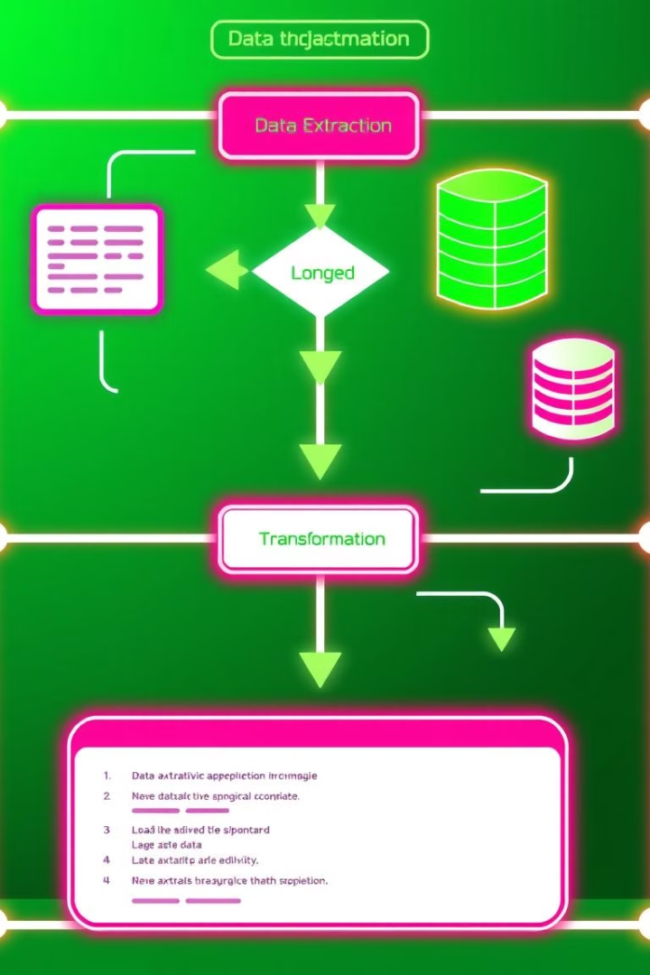
Changing Data
First time load
Warehouse Database
Operational Database
Refresh
Refresh
Refresh

Slide 7
Data Warehouse Versus OLTP
Property | Operational | Data Warehouse
Response Time | Sub seconds to seconds | Seconds to hours
Operations | DML | Primarily read only
Nature of Data | 30-60 days | Snapshots over time
Data Organization | Applications | Subject, time
Size | Small to large | Large to very large
Data Source | Operational, Internal | Operational, Internal, External
Activities | Processes | Analysis

Slide 8

Usage Curves
Operational system is predictable Data warehouse
Variable
Random

Slide 9
User Expectations
Control expectations
Set achievable targets for query response Set SLAs
Educate
Growth and use is exponential

Slide 10

Enterprisewide Warehouse
Large scale implementation Scope the entire business Data from all subject areas Developed incrementally
Single source of enterprisewide data Single distribution point to dependent data marts

Slide 11
Data Warehouses Versus Data Marts
Data Mart
Property | Data Warehouse | Data Mart
Scope | Enterprise | Department
Subject | Multiple | Single-subject, LOB
Data Source | Many | Few
Size(typical) | 100 GB to>1 TB | <100 GB
Implementation time | Months to years | Months

Slide 12
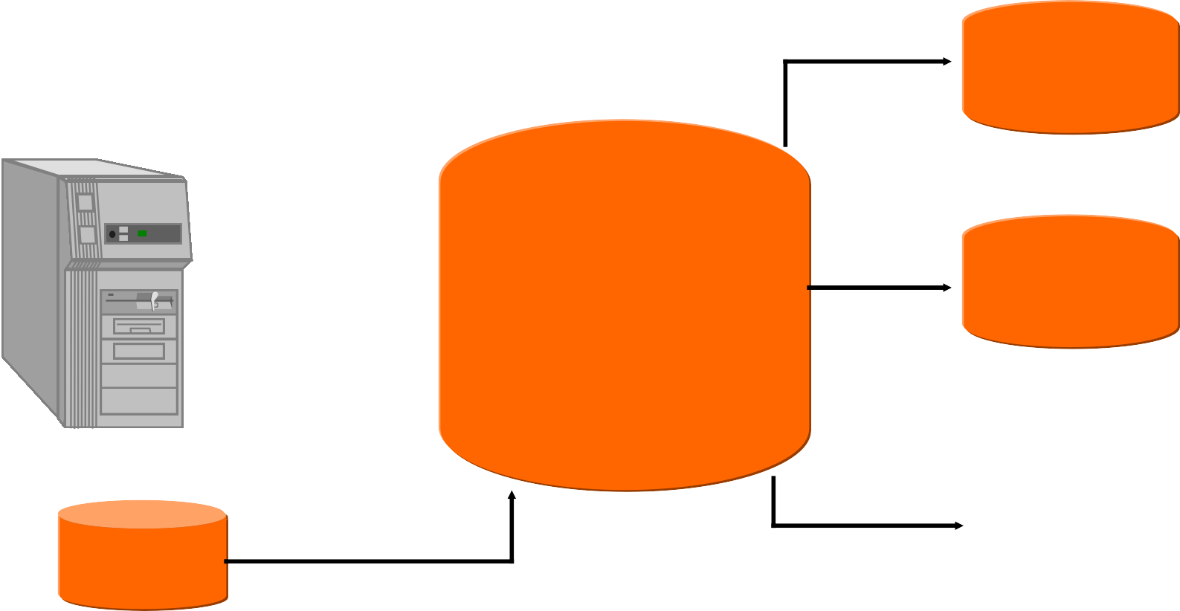
Dependent Data Mart
Flat Files
Operational Systems
Marketing
Marketing Sales Finance
Human Resources
Data Warehouse
Marketing
Marketing Data Marts
External Data

Slide 13
Independent Data Mart
Flat Files
Flat Files
Sale or Marketing
External Data

